Slide 1
Unit 1
Introduction

Slide 2

Digital Image
A digital image is a representation of a real image as a set of numbers that can be stored and handled by a digital computer.
A digital image is a binary representation of some visual information.
Eg. Simple drawing, photographed pictures recorded graphs, logos of the organization
They all can be stored and saved for future use electronically in any storage device.

Slide 3
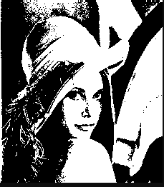

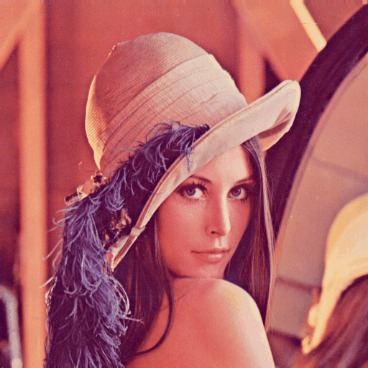
Types of Image
Binary image
White and black image/Grayscale image
Color image

Slide 4
Fundamental steps in Image Processing
Image Acquisition
Pre-processing
Image Enhancement
Image Restoration
Knowledge Base
Object Recognition
Image Representation and Description
Color image Processing

Slide 5
Image Acquisition
Capture images using devices such as cameras, scanners, or sensors.
Convert real-world scenes into digital representations.
Digital Cameras:
Capture images using optical sensors.
Offer various features such as adjustable lenses, autofocus, and exposure settings.
Used in photography, videography, and surveillance systems.
Scanners:
Convert physical documents or images into digital form.
Flatbed scanners, document scanners, and film scanners are common types.
Used for digitizing printed photos, documents, and artwork.

Slide 6
Cont..
Smartphones:
Equipped with built-in cameras capable of capturing high-quality images.
Offer features like autofocus, image stabilization, and HDR mode.
Widely used for everyday photography, social media sharing, and mobile applications.
Satellite and Aerial Imaging Systems:
Capture images of the Earth's surface from space or aircraft.
Used for mapping, environmental monitoring, agriculture, and urban planning.
Medical Imaging Devices:
Include X-ray machines, MRI scanners, CT scanners, ultrasound machines, etc.
Capture images of the human body for diagnostic and treatment purposes.
Used in healthcare for detecting diseases, injuries, and abnormalities.

Slide 7
Pre-processing
Initial processing to enhance image quality.
Resizing and Rescaling
Normalization
Grayscale Conversion
Noise Reduction
Contrast Enhancement
Edge Detection
Smoothing and Sharpening
Rotation and Cropping
Data Augmentation

Slide 8
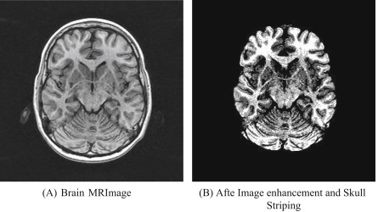
Image Enhancement
Improve the visual appearance of images for better interpretation.
Techniques include contrast adjustment, brightness correction, and sharpening filters

Slide 9
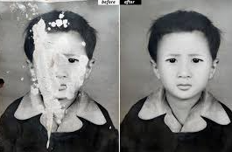
Image Restoration
Recover images from degraded versions caused by noise, blurring, or other factors.
Utilize mathematical models and algorithms to restore image fidelity.

Slide 10
Color Image Processing
Handle and manipulate color information within digital images.
Techniques Used in Color Image Processing
Color Space Conversion:
Color Enhancement:
Color Filtering and Segmentation:
Color Quantization:
Color Histograms:
Color Correction:
Color Image Compression:

Slide 11
Applications of Color Image Processing
Medical Imaging: Color image processing is used in medical imaging for various purposes such as tumor detection, cell counting, and histology.
Remote Sensing: Color image processing is used in remote sensing to analyze satellite images for various applications such as land use classification, vegetation analysis, and disaster management.
Surveillance: Color image processing is used in surveillance for object detection, face recognition, and license plate recognition.
Entertainment: Color image processing is used in the entertainment industry for various purposes such as video games, movies, and animations.

Slide 12
Image Compression
Reduce storage size or transmission bandwidth required for images.
Types of Image Compression:
Lossy Compression:
Irreversibly discards some image data to achieve higher compression ratios.
Results in some loss of image quality, especially after multiple compression-decompression cycles.
Examples include JPEG, MPEG, and MP3.
Lossless Compression:
Reduces image size without sacrificing any image quality.
Achieves compression by removing redundancy in the image data.
Examples include PNG, GIF, and TIFF.

Slide 13
Morphological Processing
Analyze and manipulate image shapes and structures.
Includes operations such as
Dilation
Dilation is a morphological operation that expands the boundaries of objects in a binary image.
erosion
Erosion is the opposite of dilation. It shrinks the boundaries of objects in a binary image.
opening
Opening is a compound operation that consists of an erosion followed by a dilation.
Closing
It consists of a dilation followed by an erosion. Closing is effective for filling small holes, connecting broken parts of objects, and smoothing object boundaries while preserving the shape and size of the objects.

Slide 14
Applications
Image Segmentation:
Separating objects from the background or from each other based on their morphological characteristics.
Used in object detection, recognition, and measurement tasks.
Noise Reduction:
Removing small, unwanted elements or irregularities from images.
Helps improve image quality and enhance subsequent processing steps.
Feature Extraction:
Identifying and extracting meaningful features such as edges, corners, or blobs from images.
Used in pattern recognition, object tracking, and computer vision applications.
Morphological Filtering:
Enhancing or modifying image structures using morphological operations.
Useful for image enhancement, texture analysis, and image synthesis tasks.

Slide 15
Image Segmentation
Partition images into meaningful regions or objects.
Image segmentation is the process of partitioning an image into multiple segments or regions based on certain characteristics, such as color, intensity, texture, or motion.
goal of segmentation is to simplify and/or change the representation of an image into more meaningful and easier-to-analyze parts.
Essential for object detection, recognition, and image understanding

Slide 16
Feature Extraction
Identify and extract relevant features from images.
Features may include edges, textures, shapes, or keypoints.
Feature extraction is the process of extracting relevant information or features from raw data, such as images, text, audio, or sensor data, to represent it in a more compact and meaningful form.
In the context of image processing and computer vision, feature extraction involves identifying distinctive patterns, structures, or characteristics in an image that can be used to describe its content or facilitate further analysis.

Slide 17
Object Recognition/Classification
Assign labels or categories to objects or regions within images.
Utilize machine learning algorithms, pattern recognition, and classification techniques.
Various classification algorithms can be used for object recognition, including support vector machines (SVM), decision trees, random forests, k-nearest neighbors (KNN), and deep neural networks (DNN). Deep learning-based approaches, particularly convolutional neural networks (CNNs)

Slide 18
Post-processing
Finalize processed images for specific applications.
Includes tasks like
image fusion
Combining multiple images of the same scene taken under different conditions or with different sensors to produce a single composite image with improved quality or additional information.
image stitching
Image stitching is a process of combining multiple overlapping images to create a larger, panoramic image that represents a wider field of view than any single input image.
Compression
Annotation and Metadata Addition
Adding annotations, labels, or metadata to images for documentation, analysis, or presentation purposes.

Slide 19
Display and Interpretation
Present and visualize processed images for human interpretation.
Display on screens or printing on physical media for analysis or presentation.
the display and interpretation steps in image processing are essential for visualizing the results of processing algorithms, extracting meaningful information from images, and making informed decisions based on the analyzed data.
These steps are often iterative and may involve feedback loops to refine processing parameters or improve the accuracy of interpretation results.

Slide 20
Elements of Digital Image Processing systems
The basic operations performed in a digital image processing systems include
Acquisition
Storage
Processing
Communication
Display.

Slide 21
Storage
Optical Disks
Hard Disk Drives (HDD)
Solid State Drives (SSD)
Tape
Cloud Storage
Network-Attached Storage (NAS)
Image Acquisition Equipment
Video
Scanner
Camera
Display Unit
TV monitor
Projectors
Printers
Slides
Processing Unit
Computer
workstation
Communication Channel

Slide 22
Element of Visual Perception
The field of digital image processing is built on the foundation of mathematical and probabilistic formulation, but human intuition and analysis play the main role to make the selection between various techniques, and the choice or selection is basically made on subjective, visual judgments.
In human visual perception, the eyes act as the sensor or camera, neurons act as the connecting cable and the brain acts as the processor.
The basic elements of visual perceptions are:
Structure of Eye
Image Formation in the Eye
Brightness Adaptation and Discrimination

Slide 23
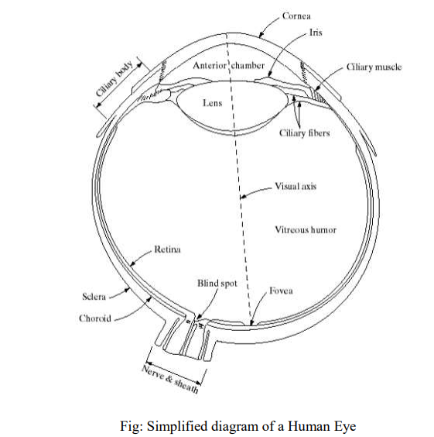
Structure of Human Eye

Slide 24
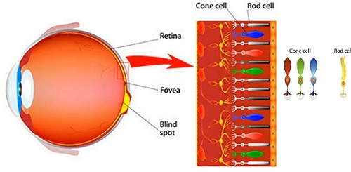
Cont..

Slide 25
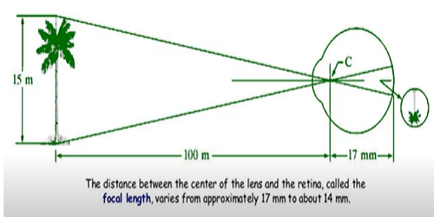
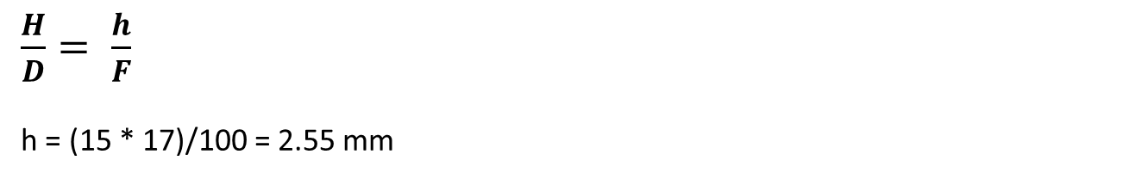
Image Formation in the Eye
$\frac{H}{D}= \frac{h}{F}$
h = (15 * 17)/100 = 2.55 mm

Slide 26
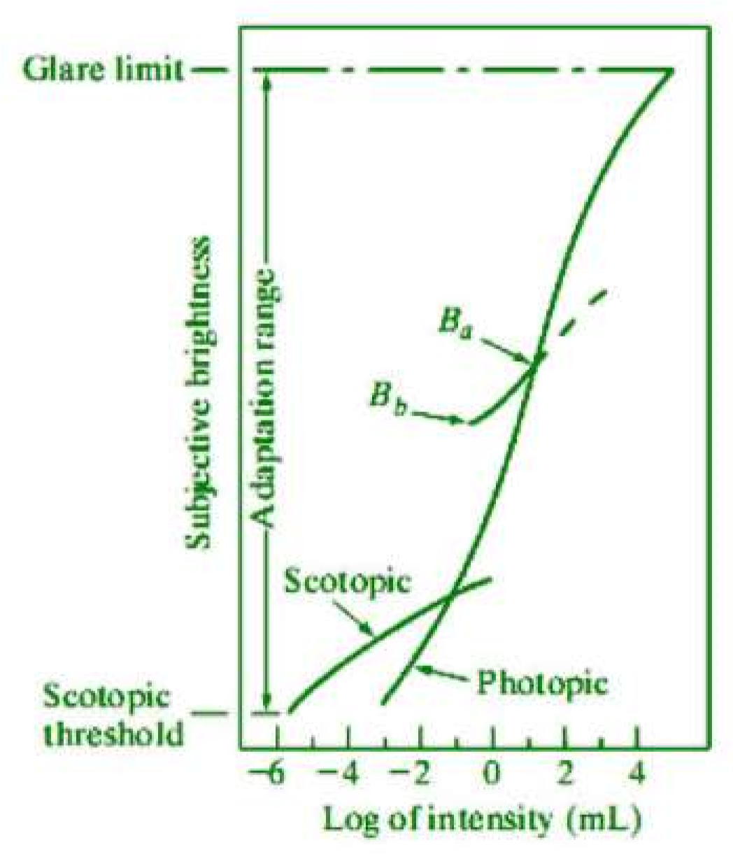
Brightness Adaptation and Discrimination
The digital images are displayed as a discrete set of intensities (brightness), the human eye’s ability to discriminate between different intensity levels is an important consideration in image processing. The range of light intensity level to which the human visual system (HVS) can adapt is order of 10¹⁰ from the Scotopic threshold to the glare limit. The subjective brightness (intensity perceived by HVS) is a log of intensity incident on the eye.

Slide 27
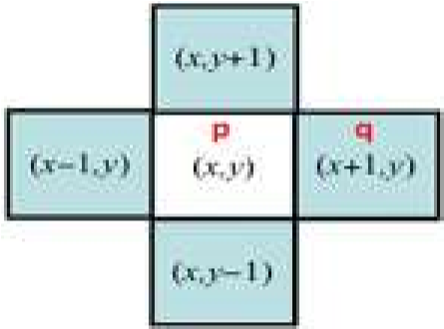
Some Basic Relationships between Pixels
There are several important relationships between pixels in a digital image. A digital image is denoted by f(x, y). Here, a particular pixel is denoted by lowercase letters such as p and q. Neighbors of a Pixel
A pixel p, at coordinates (x, y) has four neighbors as two horizontal and two vertical neighbors whose coordinates are given by (x+1, y), (x-1, y), (x, y+1), (x, y-1)
This set of pixels are called the 4-neighbors of p, is denoted by N₄(p)
Each pixel is a unit distance from (x, y), and some of the neighbors of p lie outside the digital image, if (x, y) is on the border of the image.
The four diagonal neighbors of p as N_{D}(p) have coordinates (x+1, y+1), (x+1, y-1), (x-1, y+1), (x-1, y-1)

Slide 28
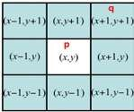
Cont.
The four diagonal neighbors of p as N_{D}(p) have coordinates (x+1, y+1), (x+1, y-1), (x-1, y+1), (x-1, y-1)
These points, together with the 4-neighbors, i.e. N₄(p) + N_{D}(p) = N₈(p) are called the 8-neighbors of p.
As before, some of the points in N_{D}(p) and N₈(p) falls outside the image, if (x, y) is on the border of the image.

Slide 29
Sampling and Quantization
When we acquire the image, we have to convert sense data in to digital form to store in digital platform.
The output of most sensors is a continuous voltage waveform whose amplitude and spatial behavior are related to the physical phenomenon being sensed.
To create a digital image, we need to convert the Image Processing continuous sensed data in to digital form.
This involves two processed
Sampling and
Quantization.

Slide 30
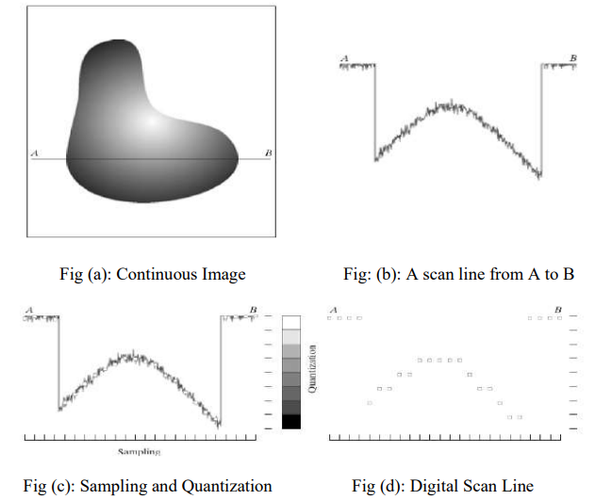
Cont..

Slide 31
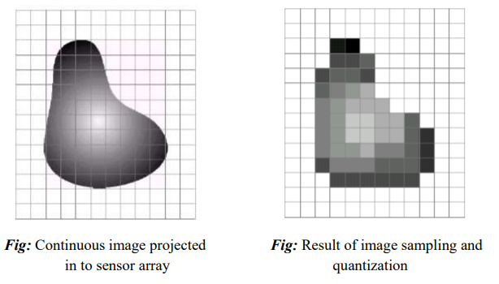
Cont.

